Slide 1
Maths at Holy Trinity
October 2018

Slide 2
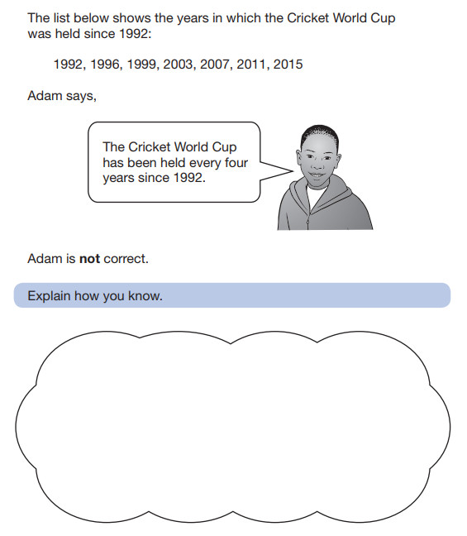
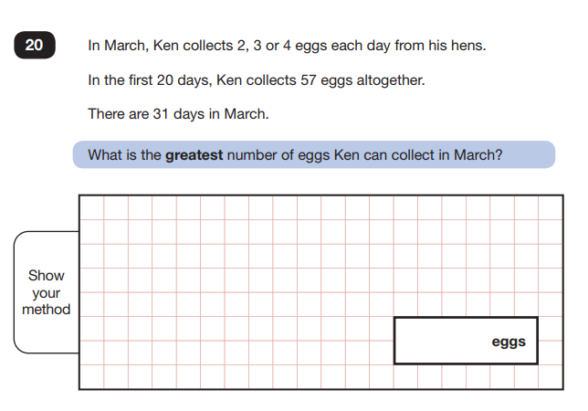
Try these …

Slide 3
Growth Mindset
‘What separates more successful people from less successful people is not the number of their successes but the number of mistakes they make’ (Boaler, 2015)
Due to the right and wrong nature many children become afraid of maths;
They are told by others that it is okay not to good be at maths;
They worry about taking a risk and having a go – maths anxiety is real.
Maths is not a ‘can or cannot do’ subject but has areas that we cannot do ‘yet’
It is very easy to help children develop a ‘fixed mindset’ where maths is concerned, but we want them to have a ‘growth mindset’
GROWING TOGETHER AS CHILDREN OF GOD

Slide 4
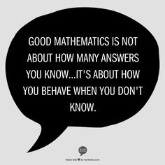
Growth Mindset
So what can we do:
Encourage and celebrate mistakes;
Model perseverance and the excitement of trying again – children naturally do this with computer games all the time;
Keep it interesting – not simply fact recall;
Always look for links between mathematical concepts so children can make connections;
Celebrate the effort not the right answer.
GROWING TOGETHER AS CHILDREN OF GOD

Slide 5
Curriculum Changes
The New Curriculum in 2014 sets higher expectations for pupil achievement and the expectation is that the majority of pupils will move through the programmes of study at broadly the same pace.
The research for the review of the National Curriculum showed that it should focus on ‘fewer things in greater depth’, in secure learning which persists, rather than relentless, over-rapid progression. The new primary curriculum is stated in year-by-year blocks, which helps teachers trace lines of development through key areas of subjects, yet still focusing on the necessary detail of each subject.
(Tim Oates – Life without levels).
GROWING TOGETHER AS CHILDREN OF GOD

Slide 6
Curriculum Changes
For a number of years, teachers have been encouraged to push and accelerate children onto new content without embedding and then deepening understanding of learning – particularly around key skills such as place value, part-part whole relationships and multiplicative reasoning. This has led to the majority of schools in England streaming and setting within whole class settings. It would not be uncommon to see in a year 4 classroom the years 2, 3, 4 and 5 curriculum being presented to different groups of children in one lesson. But how does that affect the quality of learning for all?
As a school we have previously found that setting for maths does not have the maximum impact on attainment and progress and quite often it only benefits one sub group of learners.
GROWING TOGETHER AS CHILDREN OF GOD

Slide 7
Curriculum Changes
Research conducted by The Education Endowment Foundation found that:
‘overall, setting or streaming appears to benefit higher attaining pupils and be detrimental to the learning of mid-range and lower attaining learners. On average, it does not appear to be an effective strategy for raising the attainment of disadvantaged pupils, who are more likely to be assigned to lower groups.
Low attaining learners who are set or streamed fall behind by 1 or 2 months per year, on average, when compared with the progress of similar students in classes with mixed ability groups. It appears likely that routine setting or streaming arrangements undermine low attainers’ confidence and discourage the belief that attainment can be improved through effort. Research also suggests that ability grouping can have a longer term negative effect on the attitudes and engagement of low attaining pupils.’
Current research and the knowledge that the age related expectations in the 2014 national curriculum lend themselves to being taught in mixed ability classes (all children are now expected to have covered the same objectives although some children will be working at a greater depth) has changed the approach to teaching maths nationally.
GROWING TOGETHER AS CHILDREN OF GOD

Slide 8
Maths Mastery
Mastery for ALL is the key concept behind maths mastery – all children should master the mathematics curriculum.
Therefore a key element of teaching for mastery is that the whole class is taught mathematics together, with no differentiation by acceleration to new content. The learning needs of individual pupils are addressed through careful scaffolding, skilful questioning and appropriate rapid intervention, in order to provide the necessary support and challenge.
Small-group work typically involves challenge through greater depth for the more able and support with grasping concepts and methods for less-able pupils.
‘Variation’ in set exercises is also known as ‘intelligent practice’. Such exercises usually concentrate on the same topic/method/concept but vary in how the questions are presented, often in ways that expose the underlying concept or mathematical structure, and make pupils think deeply for themselves.
GROWING TOGETHER AS CHILDREN OF GOD

Slide 9
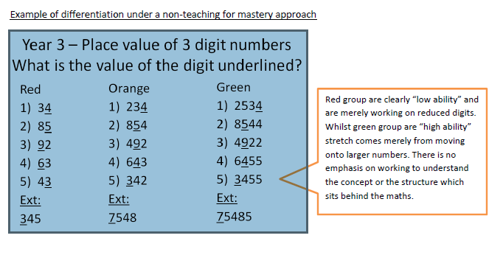
Maths Mastery
GROWING TOGETHER AS CHILDREN OF GOD

Slide 10
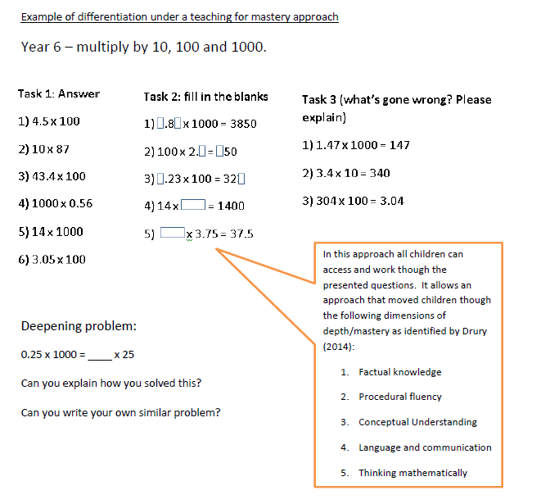
Maths Mastery
At the core of this approach is the use of key questions which promote deeper thinking:
• Spot the mistake: -80, -40, 10, 50
• Possible answers: Two numbers each with two decimal places round to 23.1 to one decimal place. The total of the numbers is 46.2. What could the numbers be?
• What’s the same, what’s different?
• True or false?
• Sometimes, always, never?
• Is it possible?
GROWING TOGETHER AS CHILDREN OF GOD

Slide 11
WRMH
GROWING TOGETHER AS CHILDREN OF GOD

Slide 12
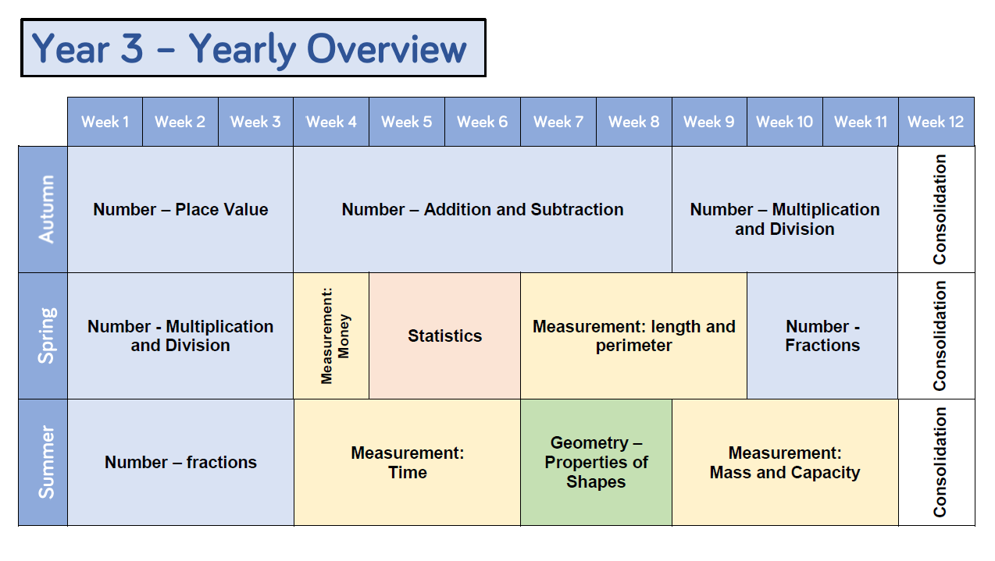
WRMH
GROWING TOGETHER AS CHILDREN OF GOD

Slide 13
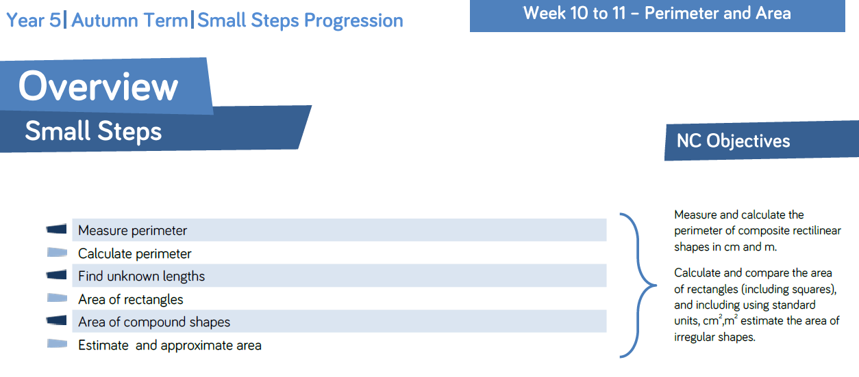
WRMH
An aspect we really liked is their breakdown into small steps – allowing pupils and teachers to see the progression of skills and knowledge needed to understand the bigger concept.
GROWING TOGETHER AS CHILDREN OF GOD

Slide 14
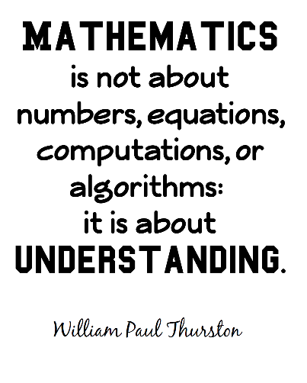
What does being a ‘good' mathematician involve?
The national curriculum for mathematics aims to ensure that all pupils:
• become fluent in the fundamentals of mathematics, including through varied and frequent practice, so that pupils develop conceptual understanding and recall and apply knowledge;
• reason mathematically by following a line of enquiry, conjecturing relationships and generalisations, and using mathematical language;
• can solve problems by applying their mathematics to a variety of routine and non-routine problems.
GROWING TOGETHER AS CHILDREN OF GOD

Slide 15
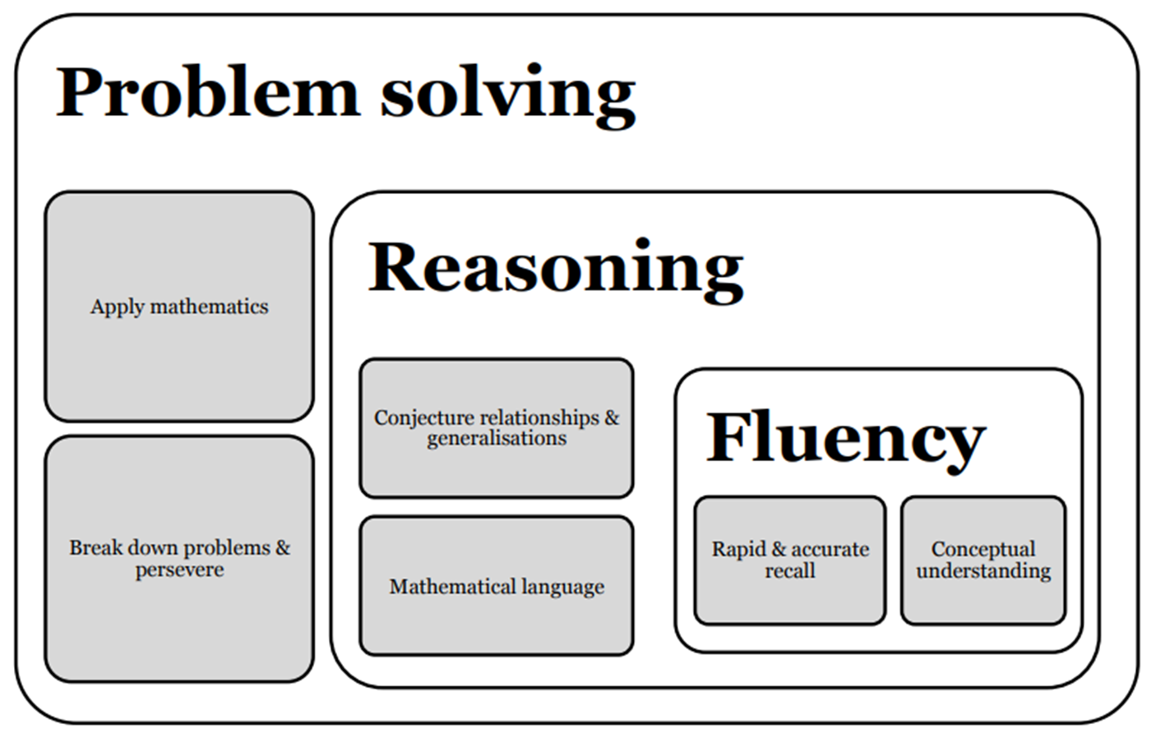
GROWING TOGETHER AS CHILDREN OF GOD

Slide 16
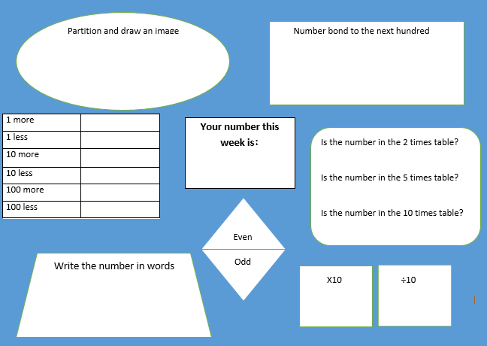
Fluency activities
Times tables
Number bonds
Using manipulatives to improve conceptual understanding
GROWING TOGETHER AS CHILDREN OF GOD

Slide 17
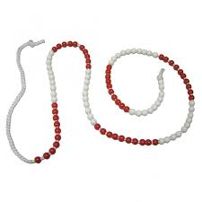
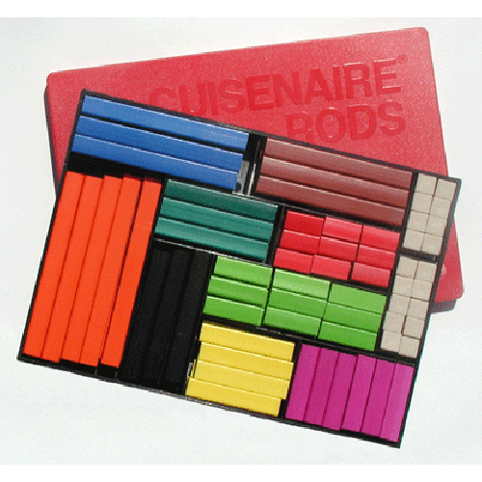
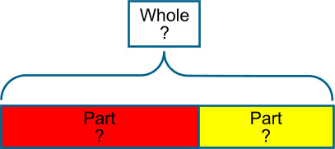
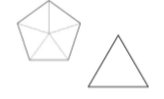
Conceptual understanding
Bead strings
Cuisenaire rods
Multilink cubes
Number line
100 grids
Bar model
Dienes blocks
Fraction towers
Shapes
GROWING TOGETHER AS CHILDREN OF GOD

Slide 18
Reasoning
… research by Terezinha Nunes (2009) identified the ability to reason mathematically as the most important factor in a pupil’s success in mathematics.
GROWING TOGETHER AS CHILDREN OF GOD

Slide 19
Reasoning
Reasoning relates to a child’s mathematical thinking and use of language to support this. Skills involved might include:
Exploring, wonder, questioning and conjecture;
Comparing, classifying and sorting;
Experimenting, play with possibilities, modify an aspect to see what happens;
Making theories, generalisations and predictions and act purposefully to see what happens.
GROWING TOGETHER AS CHILDREN OF GOD

Slide 20
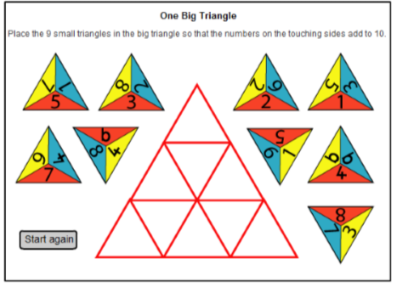
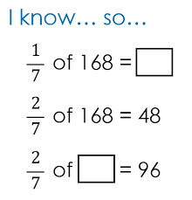
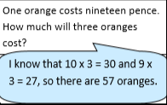
Reasoning activities
What do you notice?
Spot the mistake
True or false?
Give an example of…
Odd one out
Continue the pattern
Do, then explain
Convince me/prove it
GROWING TOGETHER AS CHILDREN OF GOD

Slide 21
The Bar Model
Bar modelling is used widely in Singapore, Japan and USA as an effective part of the Concrete, Pictorial, Abstract (CPA) approach to the mastery of mathematics. Concrete materials are embedded alongside pictorial representations and abstract expressions to ensure procedural fluency and conceptual understanding are developed in tandem.
GROWING TOGETHER AS CHILDREN OF GOD

Slide 22
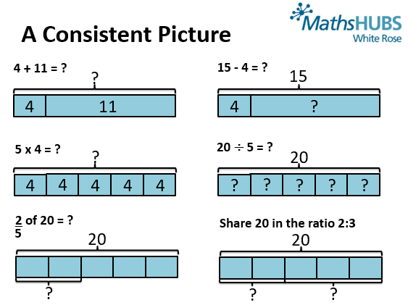
The Bar Model
“When children have experience and exposure to many concrete materials, they are able to develop the ability to visualise”
Ban Har 2016
“Instead of relying on superficial and unreliable clues like key words, the simple visual diagrams help children understand why the appropriate operations make sense.”
Beckmann 2014
GROWING TOGETHER AS CHILDREN OF GOD

Slide 23
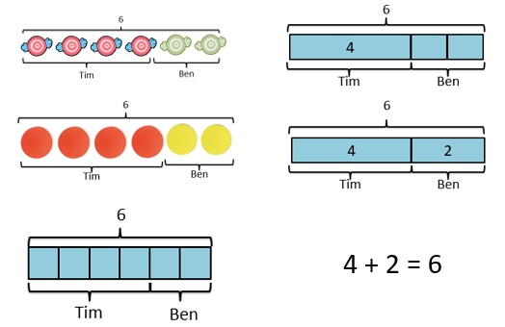
The Bar Model
GROWING TOGETHER AS CHILDREN OF GOD

Slide 24
The Bar Model
Bar model in school
Dr Yeap Ban Har
GROWING TOGETHER AS CHILDREN OF GOD

Slide 25
How We Assess
Daily teacher assessment through questioning, targeted activities and conferencing with the children;
Termly assessment week;
Levelling using the National Curriculum learning objectives in books – three tick policy;
Moderation – in house and with cluster schools;
Moderation by the borough.
GROWING TOGETHER AS CHILDREN OF GOD

Slide 26
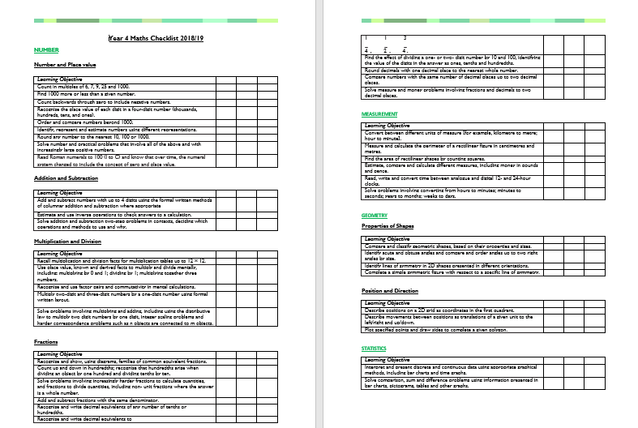
How We Assess
GROWING TOGETHER AS CHILDREN OF GOD

Slide 27
Marking & Feedback
We have moved away from deep marking and ‘next stepping’ work towards a more immediate response approach;
Pupils to self mark some pieces and reflect on learning;
We endeavour to conference with pupils about their work in class, which might be at different stages throughout the lesson itself or the next day after marking their work.
GROWING TOGETHER AS CHILDREN OF GOD

Slide 28
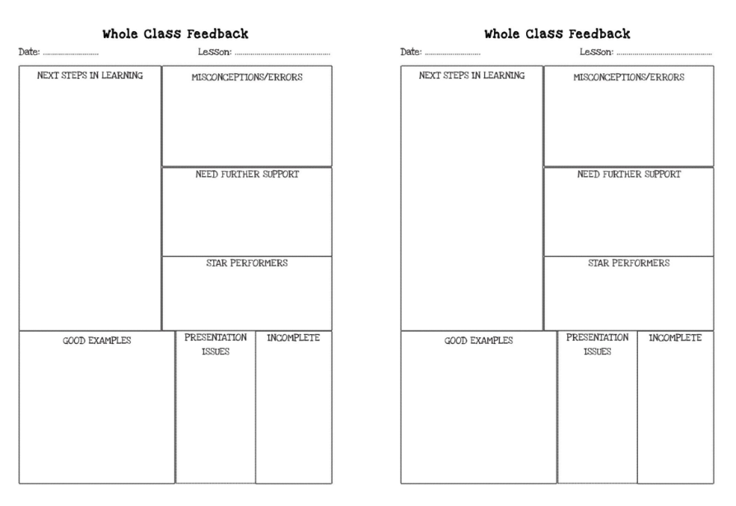
Marking & Feedback
GROWING TOGETHER AS CHILDREN OF GOD

Slide 29
Support
In class support – both planned for support and immediate support take place daily
Interventions – with TAs, with our specialist intervention teacher and with our maths specialist teacher. These maybe small groups or 1:1
Revisiting daily previous concepts to embed them
Clearly differentiated tasks and resources targeted at individuals
GROWING TOGETHER AS CHILDREN OF GOD

Slide 30
Challenge
How do we challenge in lessons?
1) Straightforward problems can be adapted to create more opportunities for reasoning and for learning about different problem-solving strategies, by:
removing intermediate steps
reversing the problem
making the problem more open
asking for all possible solutions
asking why, so that pupils explain
asking directly about a mathematical relationship.
2) Questioning, questioning, questioning!
3) Provide opportunities to use and apply mathematical thinking in a variety of scenarios.
GROWING TOGETHER AS CHILDREN OF GOD

Slide 31
Challenge
What other opportunities for challenge are there?
Challenge Maths Club for Y 4 & 5
Greater Depth pupils in Y6 having extension lessons
Participating in regional heats of Maths Quiz Club
Challenge Maths Days across school
GROWING TOGETHER AS CHILDREN OF GOD

Slide 32
Homework
The focus of homework is Fluency & Rehearsal of skills. We try to ensure that children are always able to complete homework independently or with minimal support. This is especially important in maths to avoid confusion between home and school of what strategies to use.
We use a mixture of Mathletics, our online resource, and worksheets to provide children the opportunity to practice skills and concepts at home.
GROWING TOGETHER AS CHILDREN OF GOD

Slide 33
Next Steps
Challenge days every half term
Simmering sessions
Embedding challenge groups and support across the school
Bright Sparks page – opportunities for extension and challenge
After this meeting more resources for parents will be available on the website
Share My Learning
Teaching for Mastery project – part of a Teacher Research Group with South West London Maths Hub
GROWING TOGETHER AS CHILDREN OF GOD

Slide 34
Questions
GROWING TOGETHER AS CHILDREN OF GOD

Slide 35
Thank you for your continued support
GROWING TOGETHER AS CHILDREN OF GOD

